Slide 1

NIGERIA COVID’19
BY
EMMANUEL EBIENDELE

Slide 2
OUTLINE
OVERVIEW
DATA SOURCE
DATA COLLECTION
DATA CLEANING & PREPARATION
ANALYSIS
CONCLUSION

Slide 3
OVERVIEW
Coronavirus (Covid’19) are known as respiratory viruses that can cause illness in people and animals. In rear cases, these virus circulate among animals which can evolve and infect humans.
Coronavirus(Covid’19) has affected different people in various different ways. Most of these symptoms are caused by fever, dry cough, tiredness etc.
Coronavirus (Covid’19) are also infectious and these virus has a fast spread in various countries in the world, in which Nigeria is also part of the affected countries in the world.

Slide 4
OVERVIEW
Due to this spread of coronavirus (covid’19) most countries in the world like Nigeria were force to shut down all activities such as workplaces, Airport etc. which affected the growth of Nigeria economy.

Slide 5
DATA SOURCE
NCDC WEBSITE: The Nigeria center for Diseases Control (NCDC) monitors the country’s COVID-19 situation, and releases data on metrics across all the 36 states in the country. From NCDC COVID-19 official website https://covid19.ncdc.gov.ng/ , we’ll obtain the data by performing a web extraction or web scrapping.
JOHN HOPKINS DATA RESPIRATORY: The John Hopkins University Center for Systems Science & Engineering (JHU CSSE) publishes daily data on confirmed, death and recovered cases across different countries. We’ll access the daily data for Nigeria from

Slide 6
DATA SOURCE
Their respiratory and derive related insights.
External Data: Additional data from other sources
Covid External – Nigeria Community Vulnerability Index data
Budget Data- State Budget Data
Real GDP- Real Domestic Gross Product Data

Slide 7
DATA COLLECTION
The use of web scrapping of data from NCDC website was obtained.
John Hopkins: Data were imported from Github repository.
The External Data: Such as Covid External Data, Budget Data & Real GDP were imported from a local storage.

Slide 8
DATA CLEANING & PREPARATION
The following method used for cleaning and preparing the dataset for data analysis includes:
NCDC DATA
The data type were converted with the use of appropriate string
The date column were renamed from the scraped data while the default column names were removed from the scraped data.
The comma and extra white spaces were also removed from the dataset in other to have a refined table.

Slide 9
DATA CLEANING & PREPARATION
JOHN HOPKINS DATA
The daily Nigeria confirmed cases, recovered and death case data were gotten from the global data respiratory used for data analysis.

Slide 10
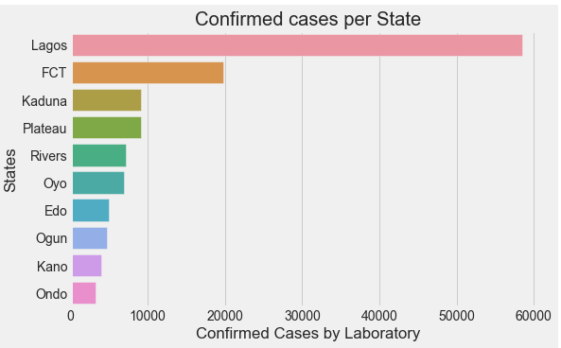
ANALYSIS
The following chat shows the top 10 states with confirmed covid’19 cases by a laboratory test in Nigeria.
Lagos state has the highest number of confirmed covid’19 cases followed FCT then Kaduna.

Slide 11
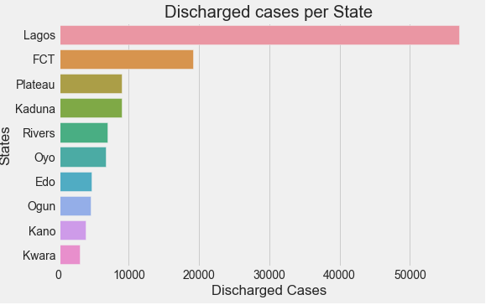
ANALYSIS
The following chats shows the top 10 discharged cases in Nigeria.
Lagos State has the highest discharged cases followed by FCT then Plateau

Slide 12
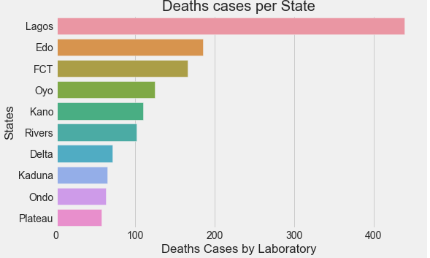
ANALYSIS
The following chat shows the top 10 states with death covid’19 cases
Lagos state has the highest death cases followed by Edo state then FCT.

Slide 13
THE NEXT SLIDE SHOWS THE FOLLOWING CHAT OF TOP ACTIVE CASES IN NIGERIA (MAY 4TH, 2021)
NIGERIA COVID’19 REAL TIME DATA ANALYSIS USING PYTHON BY EMMANUEL EBIENDELE

Slide 14
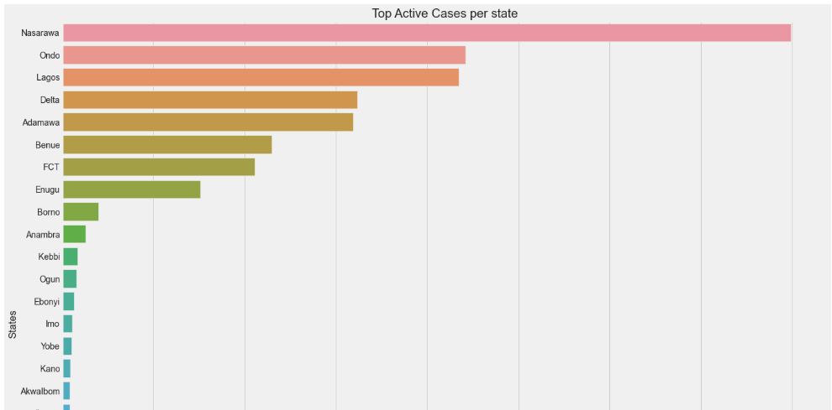
ANALYSIS

Slide 15
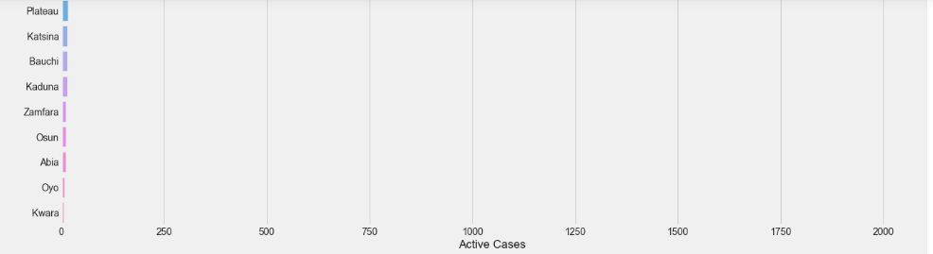
ANALYSIS

Slide 16
ANALYSIS
In summary of the previous slide Nasarawa has the highest number of active cases in Nigeria followed by Ondo state then Lagos state.
The next slides shows the following line chat of total daily confirmed, recovered and death cases in Nigeria that has occurred from January 2020- May 4th, 2021

Slide 17
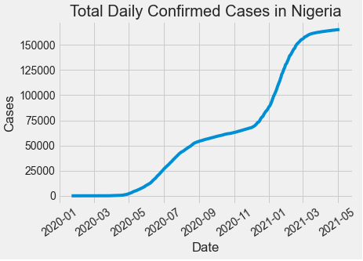
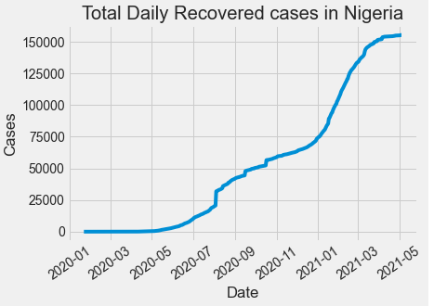
ANALYSIS
TOTAL DAILY CONFIRMED CASES
TOTAL DAILY RECOVERED CASES

Slide 18
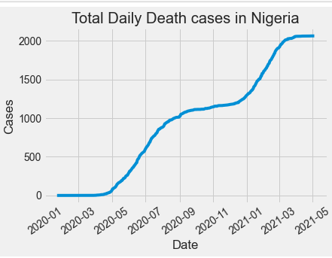
ANALYSIS
TOTAL DAILY DEATH CASES

Slide 19
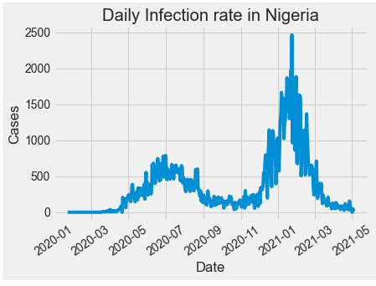
ANALYSIS
The following line chat shows the daily infection rate in Nigeria that has occurred from January 2020- May 4th, 2021.

Slide 20
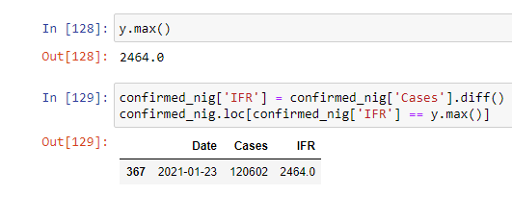
ANALYSIS
The following analysis shows the maximum rate that occurred in January 23rd, 2021.
The maximum infection rate recorded 2,464 new cases in January 23rd, 2021.

Slide 21
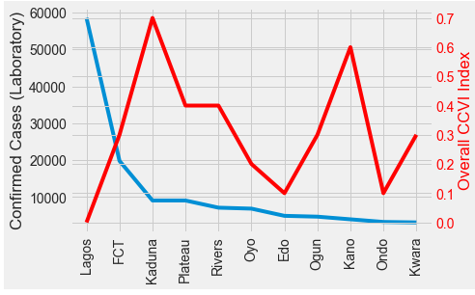
ANALYSIS
The following chat shows the top 10 state confirmed covid’19 cases, with overall vulnerability index.

Slide 22
ANALYSIS
From observation of the previous slides, Northern state has the highest vulnerability index score, in relation to the confirmed cases in Nigeria, due to the weak health systems.

Slide 23
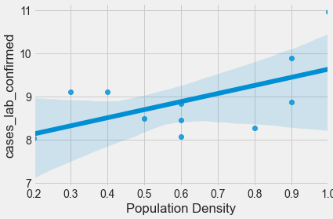
ANALYSIS
From observation of the following chat, confirmed covid’19 cases and population density have positive correlation, and there are high cases in areas that are densely populated.

Slide 24
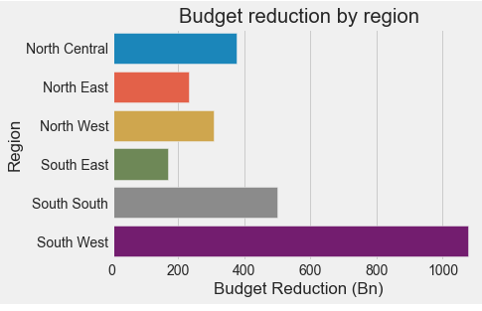
ANALYSIS
The following chat shows budget reduction that affected Nigeria economy during covid’19
From observation of these chat, south west recorded the highest number of confirmed cases & reduction in budget

Slide 25
ANALYSIS
South west region experienced the longest duration of lock down and government were forced to shut down the major economic activities which also served as the effect of budget reduction in south west region.

Slide 26
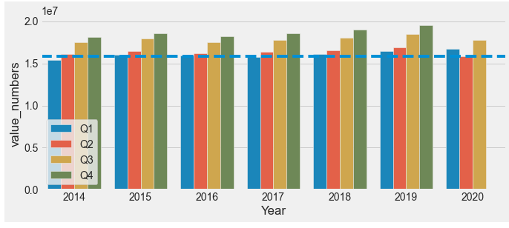
ANALYSIS
The following chat shows the GDP on Nigeria Economy
From the following chat, Q2 (Quarter 2) of 2020 has the lowest GDP compare to other Q2 from other year due to the affection of covid’19 which started 2020

Slide 27
CONCLUSION
Lagos State has the highest number of confirmed cases
Lagos State has the highest number of discharged cases
Nasarawa State has the highest number of active cases
There were increase in daily confirmed cases, recovered cases and deaths cases.
The maximum infection rate recorded 2,464 new cases in January 23rd, 2021.

Slide 28
CONCLUSION
Northern State has the highest vulnerability index score, in relation to the confirmed cases in Nigeria, due to the weak health system.
Lagos has a high number of confirmed cases but has a less vulnerability index score due to good health systems and performing the rule of social distancing .
Confirmed covid’19 cases and population density have positive correlation, and there are high cases in areas that are densely populated.

Slide 29
CONCLUSION
South west recorded the highest number of confirmed cases & reduction in budget.
South west region experienced the longest duration of lock down and government were forced to shut down economic activities which also served as the effect of budget reduction in south west region.
Q2 (Quarter 2) of 2020 has the lowest GDP compared to other Q2 from other year due to the affection of covid’19 which started in year 2020.

